Slide 1
Stock Patterns ‘R’ Us
Stock Analysis
By Candlestick Patterns
Made Easy
Notes:
Welcome to my project, Stock Patterns are Us
Stock analysis by candlestick patterns made easy

Slide 2
THE INSPIRATION
The Dow Jones Industrial Average hit its lowest level in three years.
In the 10 years after the market hit bottom in 2009, the S&P 500 has delivered a 10-year annualized total return of 17.8%.
Now is the time to buy. So how can we use data to help us make decisions?
Notes:
The stock market is basically on sale, and we haven’t seen an opportunity like this since 2008 when the last major recession happened. The coronavirus pandemic is far from over, soif you have a long-term time horizon and you are able to sustain yourself and your family during this period, Invest now while you have decades to recover, financially speaking
But how can we leverage data to help us decide what stocks to buy?
That’s where Stock Patterns Are us comes in.

Slide 3
WHAT IT DOES
Stock Patterns ‘R’ Us is a web platform that dynamically:
Scans for whether stock movement matches candlestick pattern of your choosing
Indicates whether the price is likely to rise (bullish) or fall (bearish)
Sifts through available news headlines and analyzes latest sentiment
Notes:
Stock Patterns Are us is a web platform that dynamically:
Scans for whether stock movement matches candlestick pattern of your choosing
Indicates whether the price is likely to rise or fall
Sifts through available news headlines and analyzes latest sentiment
You might ask why I chose to use candlestick patterns.
First, Candlestick patterns are technical trading tools that investors have been using for centuries to predict price direction. While some patterns can predict more accurately than others and everything is context-based, there’s a reason why the practice exists today.
Second, while candlestick charts basicaly show the same information as bar charts, they do so in in a different way. Candlestick charts are more visual, due to the color coding of the price bars and thicker real bodies, which are better at highlighting the difference between the open and the close.

Slide 4
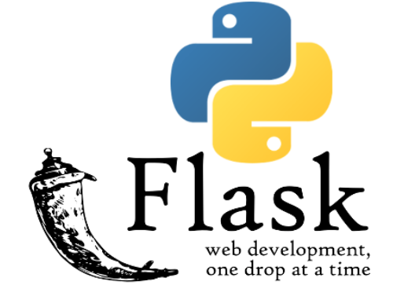
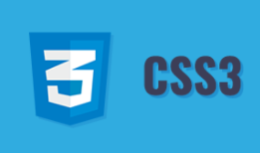


HOW I BUILT IT
Notes:
I used python flask, j query, and h t m l for the front and back end, as well as CSS and Bootstrap for styling. Beautiful soup was used to scrape news headlines and Natural Language Toolkit was used to analyze sentiments. I also leveraged Alpha Vantage API to obtain up to date stock data, charts, and news articles from stock screener site finviz.

Slide 5
DEMO
Notes:
Here’s a demo of how it works

